Slide 1

ECE 2700
Digital Circuits
Controller
Copyright © 2010 Frank Vahid
Instructors of courses requiring Vahid's Digital Design textbook (published by John Wiley and Sons) have permission to modify and use these slides for customary course-related activities, subject to keeping this copyright notice in place and unmodified. These slides may be posted as unanimated pdf versions on publicly-accessible course websites.. PowerPoint source (or pdf with animations) may not be posted to publicly-accessible websites, but may be posted for students on internal protected sites or distributed directly to students by other electronic means. Instructors may make printouts of the slides available to students for a reasonable photocopying charge, without incurring royalties. Any other use requires explicit permission. Instructors may obtain PowerPoint source or obtain special use permissions from Wiley – see http://www.ddvahid.com for information.

Slide 2
Today’s Objectives
To learn how to convert an FSM into a circuit (i.e., controller)
To understand how to check for incomplete and non-exclusive transitions

Slide 3
Design Process
Combinational Circuits
Controllers
Given a design description
  Create a truth table
  Convert into Boolean equation(s)
  Draw a corresponding circuit
Given a design description
  Create an FSM
  Set up architecture
  Encode states
  Fill truth table
  Draw a corresponding circuit

Slide 4

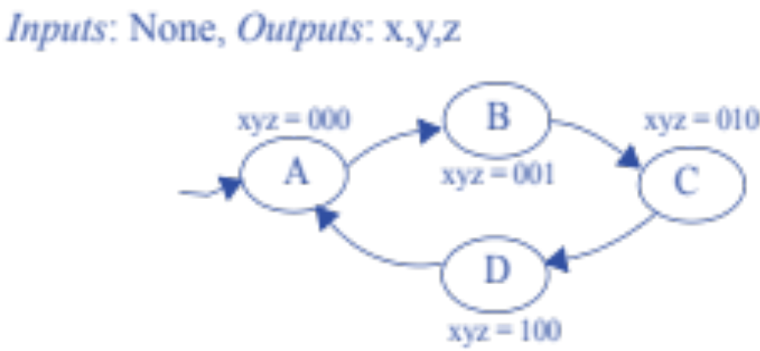
Controller Design Process
Create an FSM
Set up architecture
Encode states
Fill truth table
Draw a corresponding circuit
Input
  Clk
Outputs
  x, y, and z
Behavior
  Displays the
  following sequence
    000, 001, 010, 100, and repeat
  Output only changes on a
  rising clock edge
  000 is the initial state

Slide 5
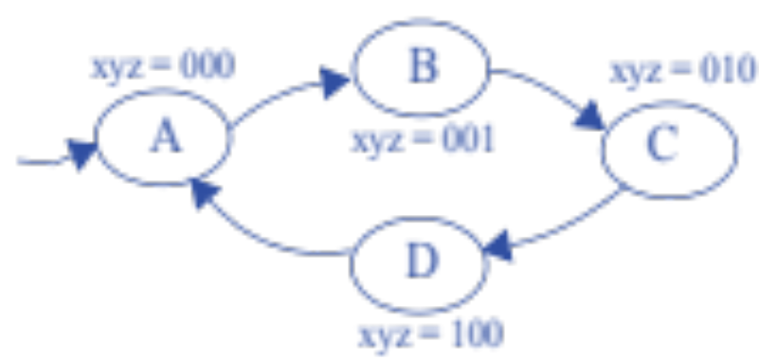
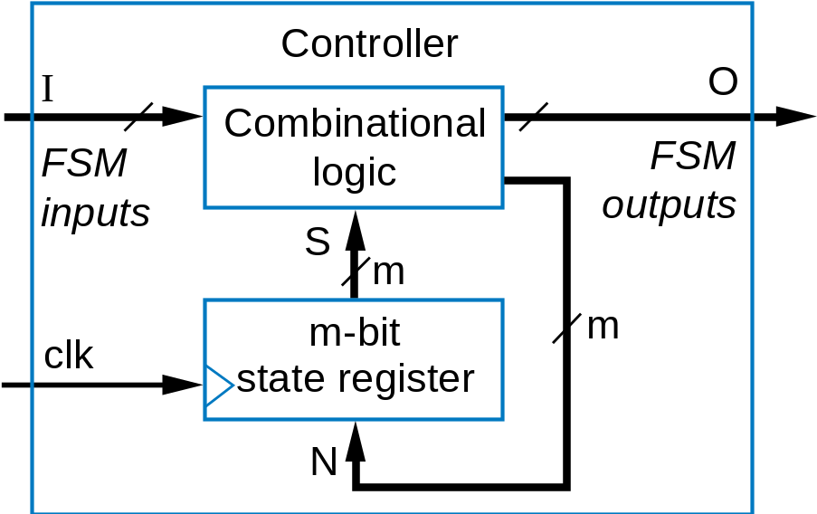
Controller Design Process
Create an FSM
Set up architecture
Encode states
Fill truth table
Draw a corresponding circuit
none
xyz
2
2
2

Slide 6
Controller Design Process
Create an FSM
Set up architecture
Encode states
Fill truth table
Draw a corresponding circuit
Any encoding with each
state unique will work
01
00
10
none
xyz
11
2
2
2

Slide 7
Controller Design Process
Inputs |  | Outputs
S1 | S0 | N1 | N0 | x | y | z
0 | 0 | 0 | 1 | 0 | 0 | 0
0 | 1 | 1 | 0 | 0 | 0 | 1
1 | 0 | 1 | 1 | 0 | 1 | 0
1 | 1 | 0 | 0 | 1 | 0 | 0
Create an FSM
Set up architecture
Encode states
Fill truth table
Draw a corresponding circuit
01
00
10
none
xyz
11
2
2
2

Slide 8

Controller Design Process
Inputs |  | Outputs
S1 | S0 | N1 | N0 | x | y | z
0 | 0 | 0 | 1 | 0 | 0 | 0
0 | 1 | 1 | 0 | 0 | 0 | 1
1 | 0 | 1 | 1 | 0 | 1 | 0
1 | 1 | 0 | 0 | 1 | 0 | 0
Create an FSM
Set up architecture
Encode states
Fill truth table
Draw a corresponding circuit
Combinational Logic
x
x = S1 S0
y = S1 S0’
z = S1’ S0
N1 = S1 + S0
N0 = S0’
y
z
N1
S1
S0
clk
State register
N0

Slide 9
Understanding the Controller’s Behavior
01
01
01
00
10
00
10
00
10
11
11
11
Combinational Logic
x
0
Combinational Logic
x
0
Combinational Logic
x
0
y
0
y
0
y
1
z
0
z
1
z
0
N1
N1
N1
0
0
0
0
1
1
1
0
1
S1
S0
S1
S0
S1
S0
clk
0 0
1
clk
0 1
0
clk
1 0
1
State register
State register
State register
N0
N0
N0

Slide 10
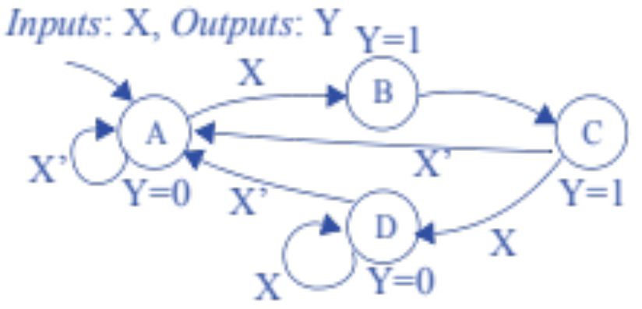
Now You Try
Create an FSM
Set up architecture
Encode states
Fill truth table
Draw a corresponding circuit

Slide 11
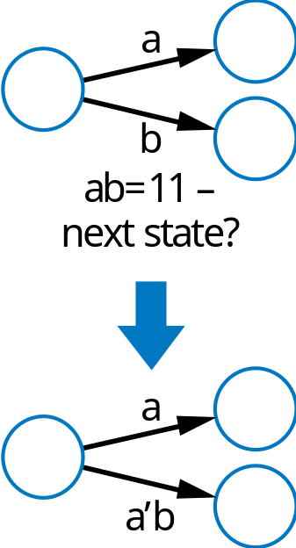
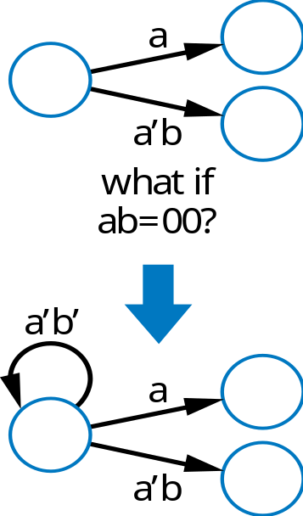
Common Mistakes When Capturing FSMs
Non-exclusive transitions
Incomplete transitions

Slide 12
Verifying Correct Transition Properties
Can verify using Boolean algebra
Exclusivity condition → Only one condition true
  ANDing each condition pair (for transitions leaving a state) should equal 0
  Proves pair can never simultaneously be true
Completeness condition → One condition true
  ORing all conditions (for transitions leaving a state) should equal 1
  Proves at least one condition must be true

Slide 13
Example
Let L = 1 if you finished lab and L = 0 otherwise
Let C = 1 if you have class and C = 0 otherwise
For State Lab transitions, prove whether
  Only one condition is true (AND of each pair is always 0)
  One condition is true (OR of all transitions is always 1)
Class
Home
L
C
Lab
L’C’ * L = 0, OK
L’C’ * C = 0, OK
L * C = ?, Fail!
L’C’ + L + C
= L’C’ + L (C + C’) + C (L + L’)
= L’C’ + LC + LC’ + LC + L’C
= L’C’ + L’C + LC’ + LC
= 1, OK
L’C’

Slide 14
Question (AP)
For the FSM to the right,
are all the transitions
exclusive?
  Yes
  No
  Don’t know
z=0
Off
w=1
z=0
w=0
z=0
First 1
w=0
First 0
w=1
w=0
w=1
z=1
z=1
Sec 1
w=0
w=1
w=0
Sec 0
w=1
w=0

Slide 15
Question (AP)
For the FSM to the right,
are all transitions complete?
  Yes
  No
  Don’t know
z=0
Off
w=1
z=0
w=0
z=0
First 1
w=0
First 0
w=0
w=1
z=1
z=1
Sec 1
w=0
w=1
w=1
Sec 0
w=0

Slide 16
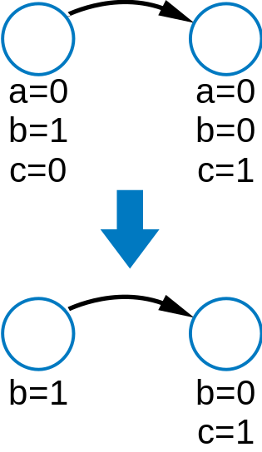
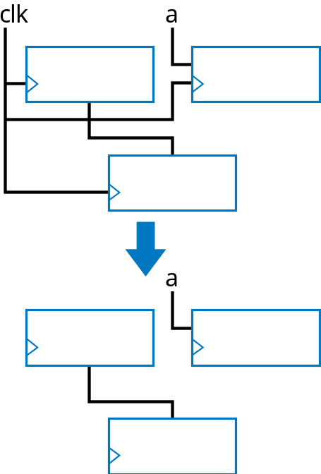
Simplifying Notations
FSMs
  Assume unassigned output implicitly assigned 0
Sequential circuits
  Assume unconnected clock inputs connected to same external clock

Slide 17
Today’s Objectives
To learn how to convert an FSM into a circuit (i.e., controller)
To understand how to check for incomplete and non-exclusive transitions

Slide 18
Question
Fill the highlighted entry in the state table
w=0
z=0
S1 | S0 | w | N1 | N0 | z
 |  |  | …
0 | 1 | 1
w=0
S1S0=00
w=1
z=0
w=0
S1S0=01
w=1
z=1
S1S0=10
w=1

